Slide 1
LSB LIRN DATABASES
Resources and Access

Slide 2
What Is the LIRN Library?
The Library and Information Resources Network is a collection of databases containing appropriate resources for faculty and student use.
This collection of databases provides access to full text articles in popular, professional, academic, and peer reviewed publications, as well as reference books, e-books, audio and video clips and transcripts.

Slide 3
Why Use LIRN?
Use LIRN to access credible resources that enhance and support your lectures.
Use LIRN to design assignments that incorporate library collections and ensure that students have access to resources necessary to complete the assignments.
Use LIRN to ensure that students are researching, retrieving, and citing credible resources to complete the assignments.
Use LIRN because its resources support the LSB
curriculum.

Slide 4
Log in to LIRN
There are two ways that you can access LIRN:
Type the LIRN URL:
  http://www.lirn.net
    Click the link to LIRN Login link
    Type the LIRN Patron Number: Ask librarian
Go to the LSB website:
  http://www.lsb.edu
    Click on Student Life
    Click on Library in the drop down menu
    Click on Online Databases
      Click the link to LIRN Login link
      Type the LIRN Patron Number: Ask librarian

Slide 5
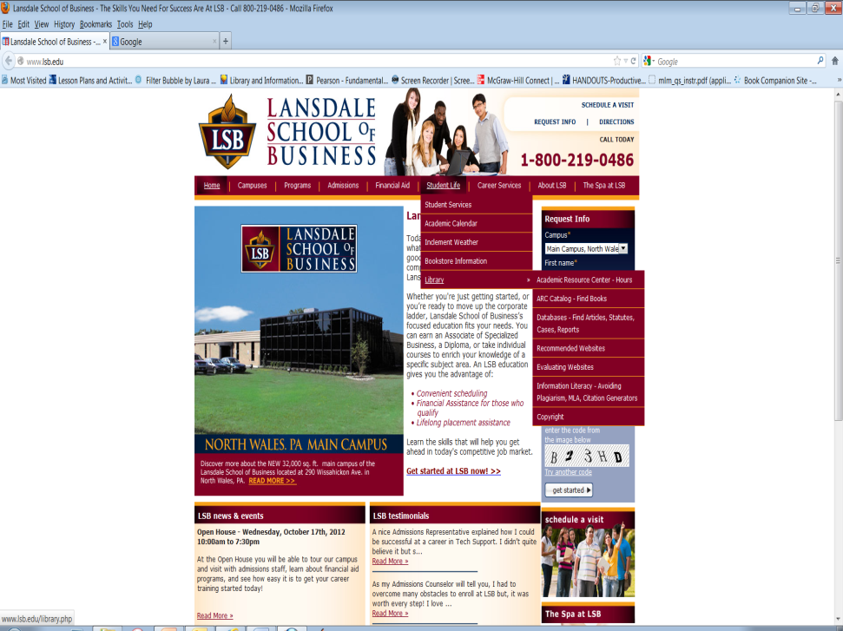
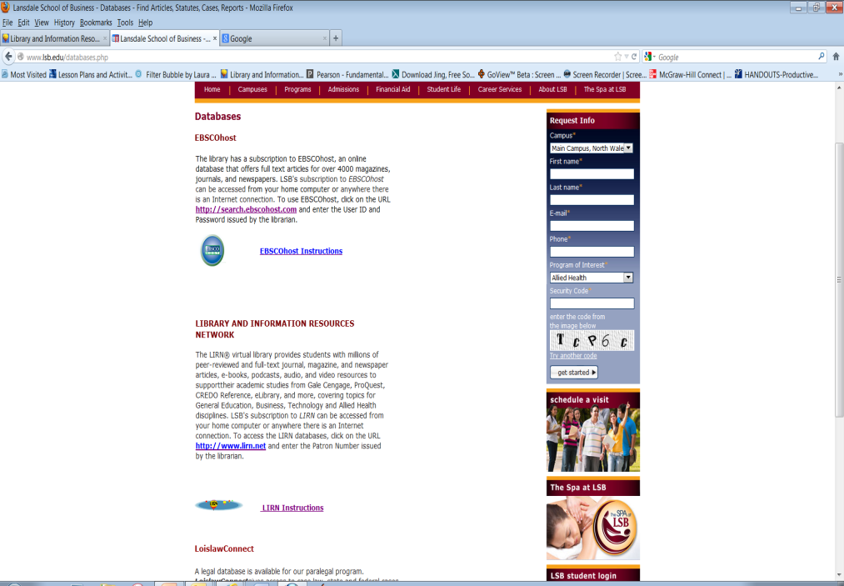
http://www.lsb.edu
Access through LSB website
Student Life – Library – Databases
Select LIRN from the Database List
Click on http://www.lirn.net
LIRN
Instructions

Slide 6
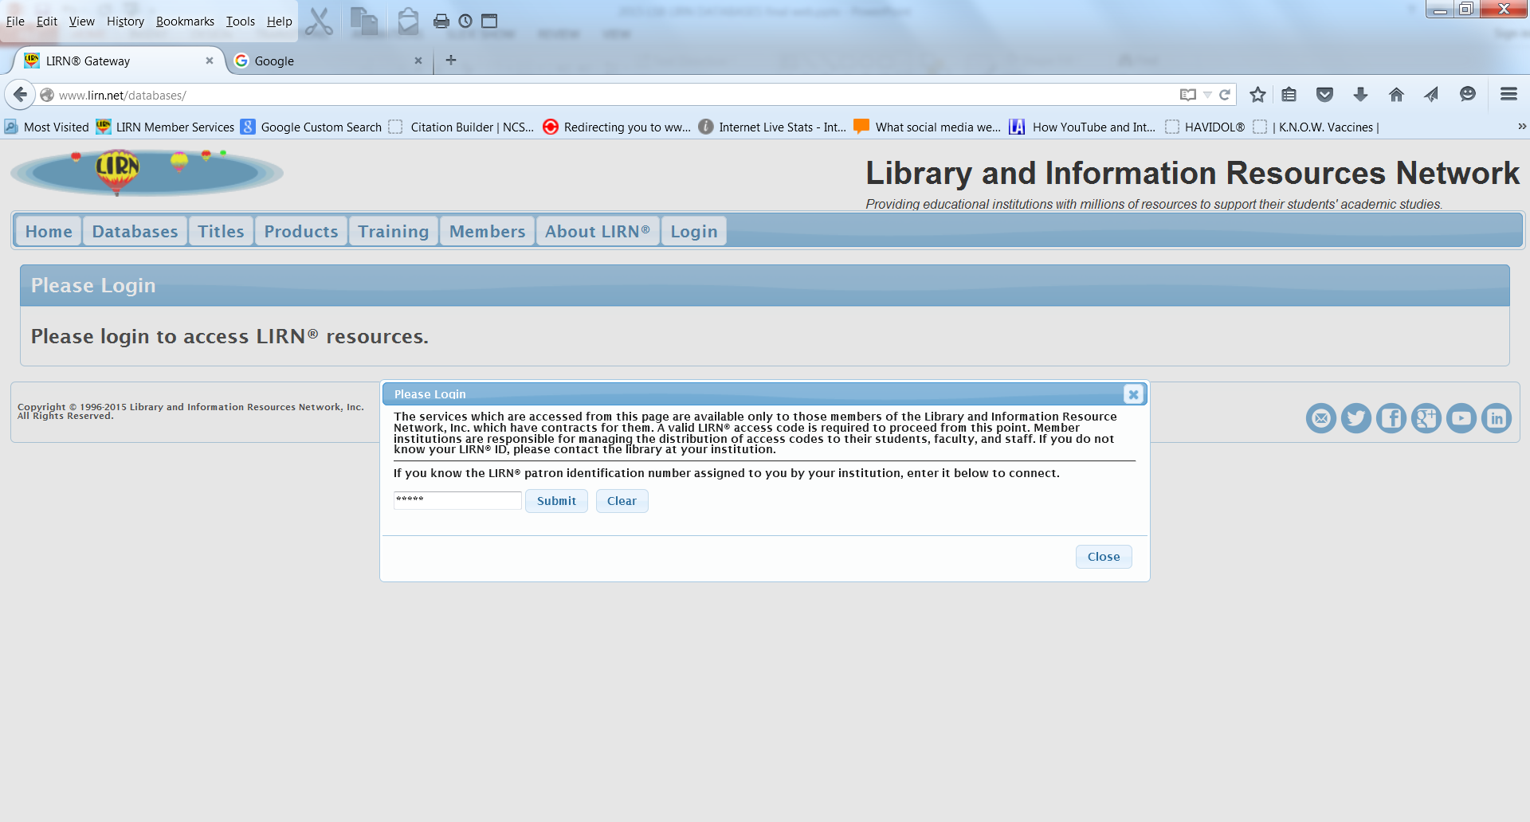
Log in to LIRN
Click on Login Tab. Type in the LIRN Patron Number and click Submit
Ask librarian
Ask Librarian for Patron ID Number

Slide 7
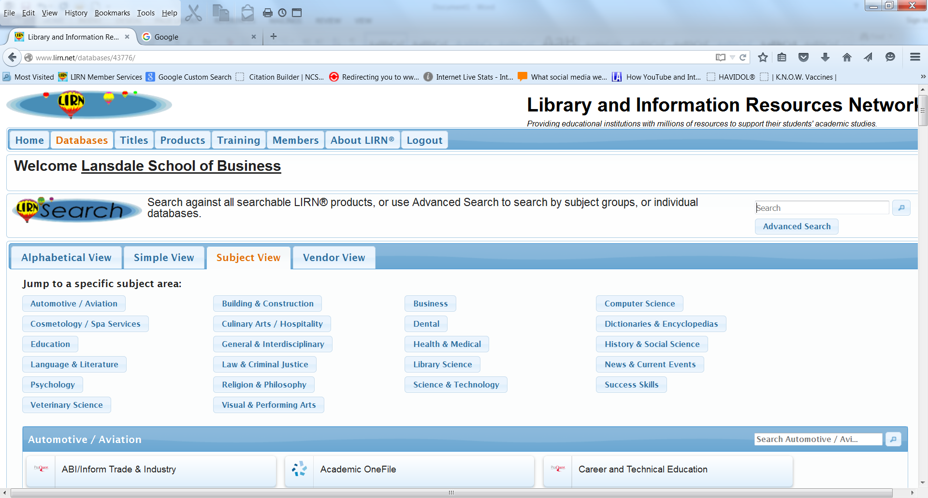
LIRN Menu of Databases
To perform a federated Advanced Search, click on the link Advanced Search.
To access e-books, presentations and tutorials and tutorials, click on Vendor View and click on Books 24x7
To access individual database resources, click on the “Connect to…” button to search that database in Subject View or Vendor View.
To view individual databases within the Subject View or Vendor View, click the database title.

Slide 8
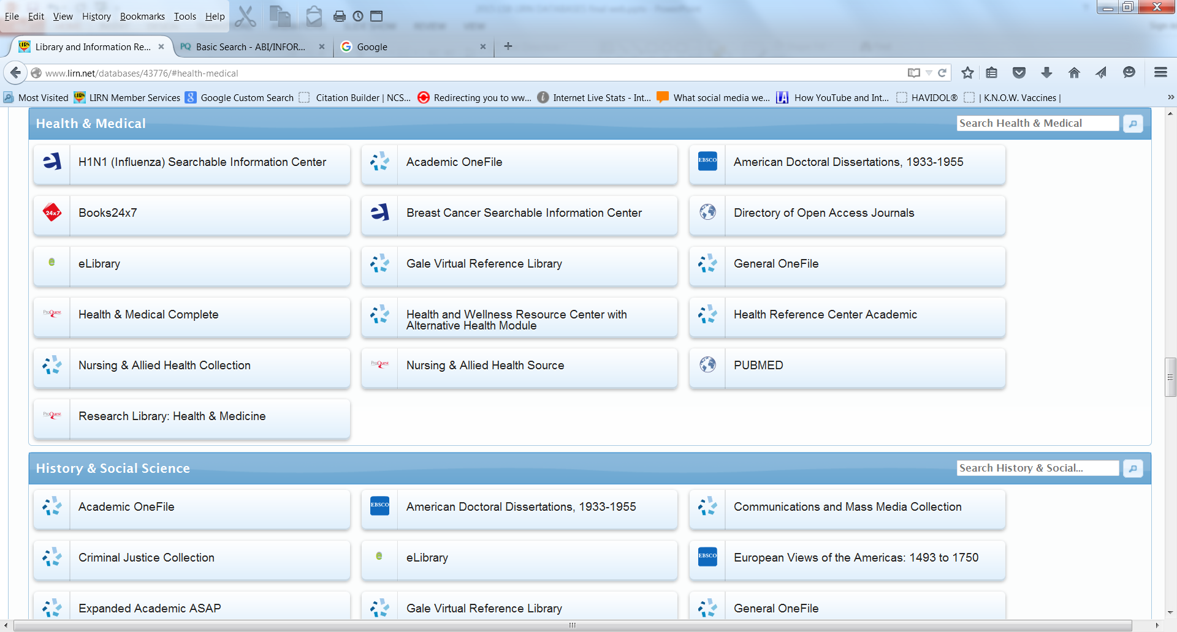
Subject View
Type in Password
Default is Subject View
Select database from the subject list for individual searching or federated searching by submitting the search term in the Subject search box.

Slide 9
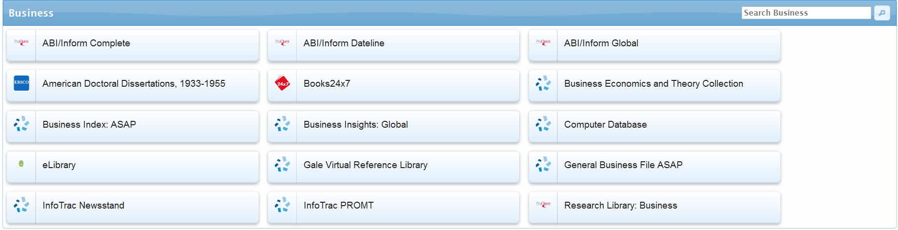
Subject View for Business
  For general information on business related topics, economics, or specific information for national and international companies, select from the following databases:
  Submit search term for federated searching
Click on an individual database to search for articles, ebooks, etc., within that database.

Slide 10
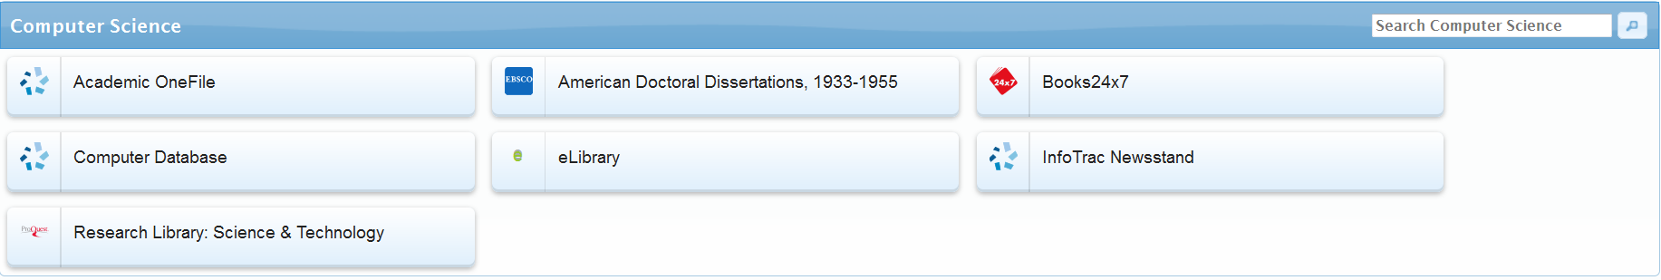
Subject View for Computers
For articles relating to computers and computer science select from the following databases:
Submit search term for federated searching
Click on an individual database to search for articles, ebooks, etc., within that database.

Slide 11
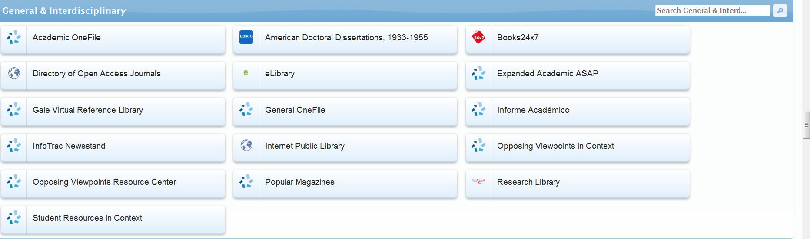
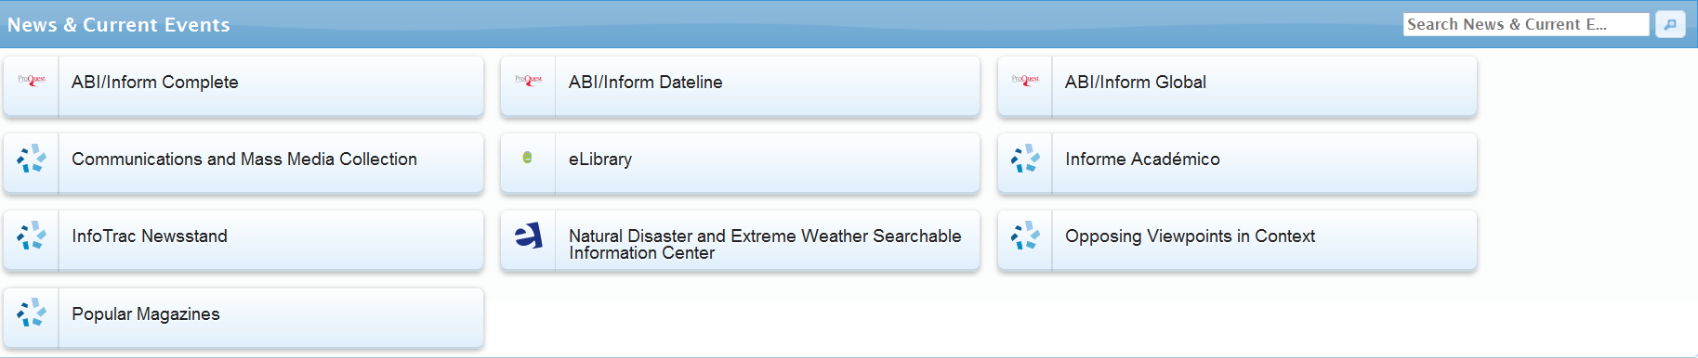
Subject View for News and Current Events
For articles relating to Contemporary Issues select from the following database collections: General and Interdisciplinary and News and Current Events.
Submit search term for federated searching
Click on an individual database to search for articles, ebooks, etc., within that database.

Slide 12
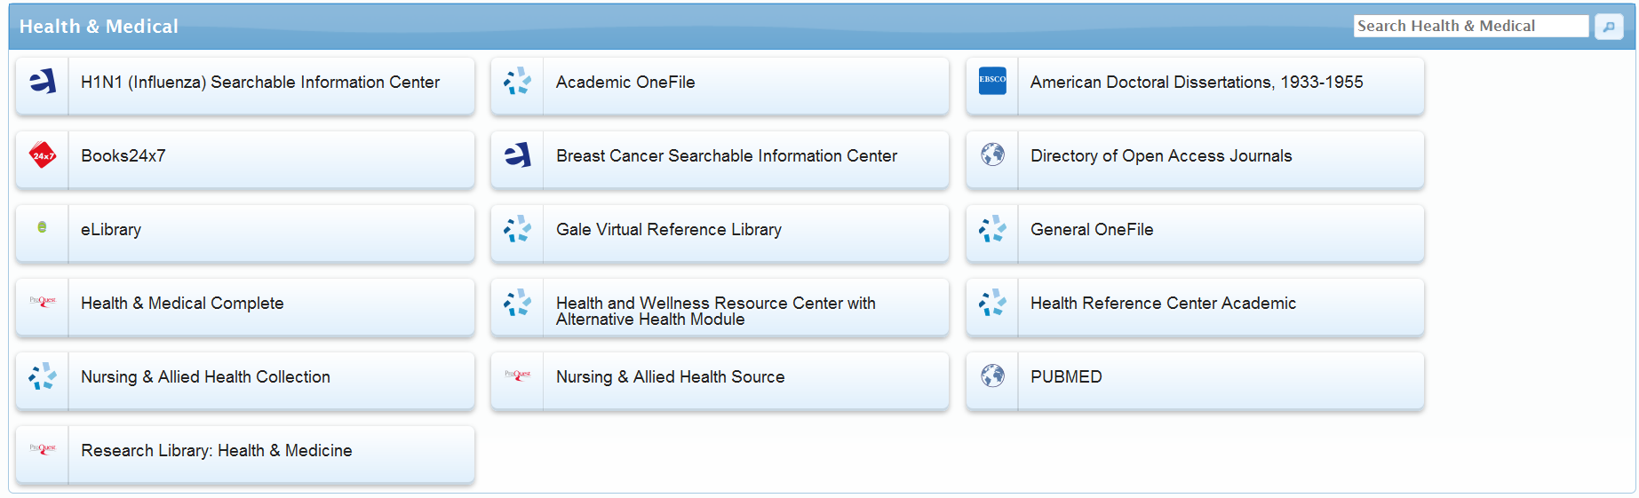
Subject View for Health and Medical
For articles relating to allied health select Health and Medical.
Submit search term for federated searching
Click on an individual database to search for articles, ebooks, etc., within that database.

Slide 13
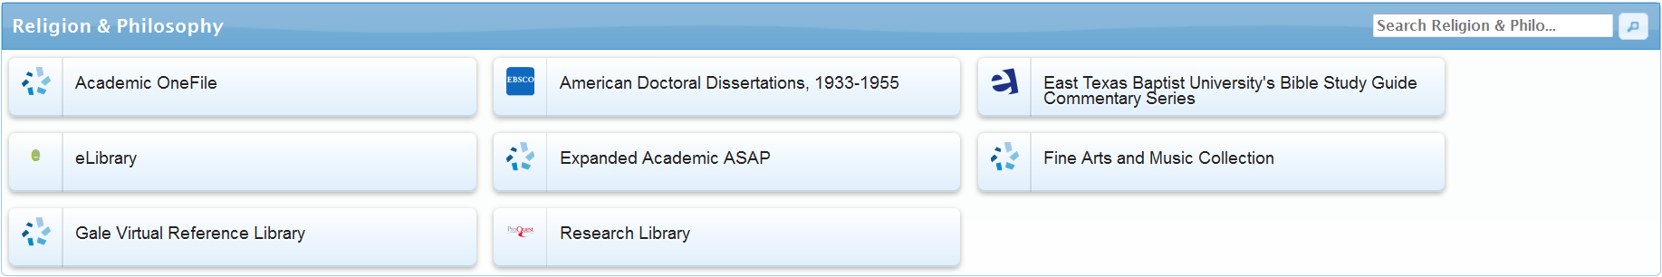
Subject View for Religion and Philosophy
For articles relating to Ethics select: Religion and Philosophy.
Submit search term for federated searching
Click on an individual database to search for articles, ebooks, etc., within that database.

Slide 14
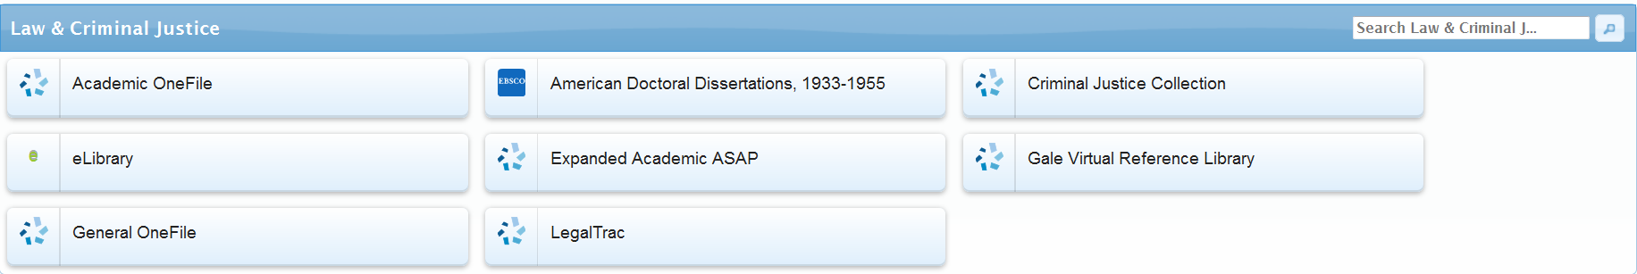
Subject View for
Law and Criminal Justice
For articles relating to criminal justice and law select: Law and Criminal Justice.
Submit search term for federated searching
Click on an individual database to search for articles, ebooks, etc., within that database.

Slide 15
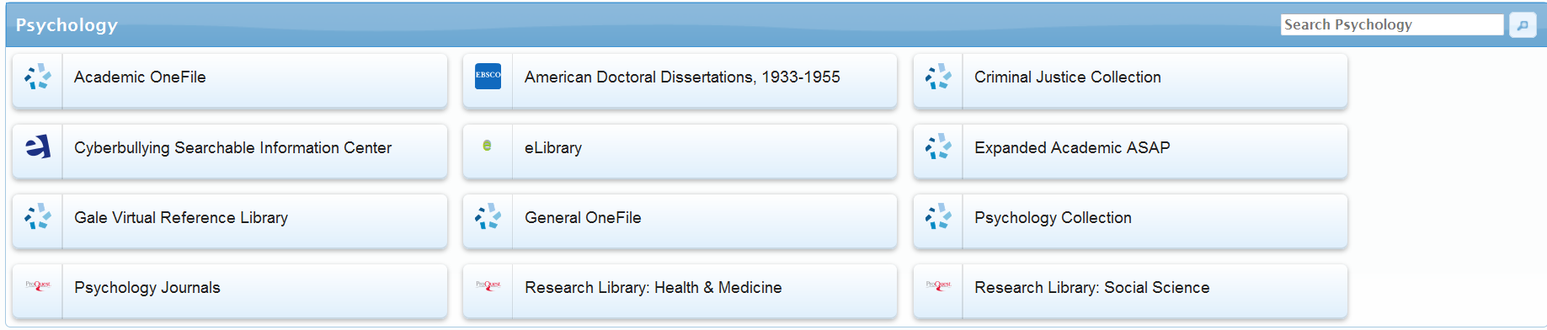
Subject View for Psychology
For articles relating to psychology select: Psychology.
Submit search term for federated searching
Click on an individual database to search for articles, ebooks, etc., within that database.

Slide 16
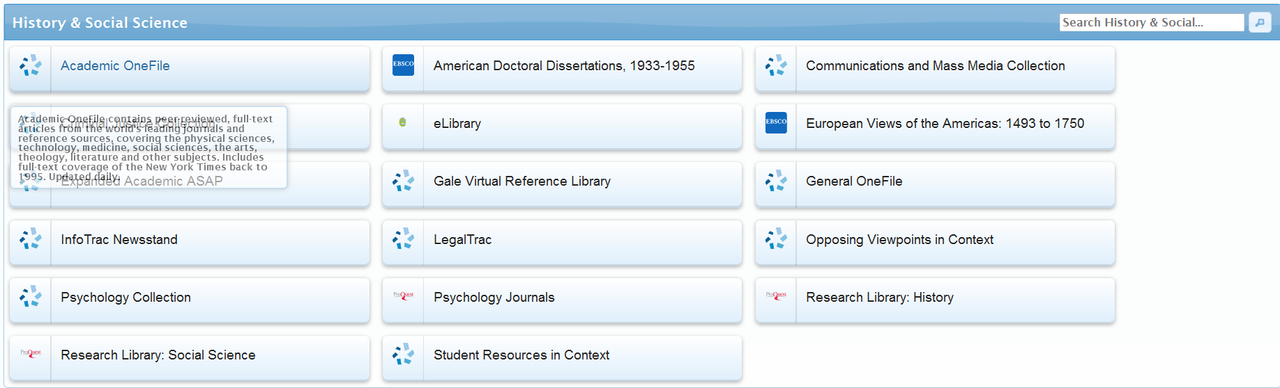
Subject View for Social Sciences
For articles relating to the social sciences select:
History and Social Sciences.
Submit search term for federated searching
Click on an individual database to search for articles, ebooks, etc., within that database.

Slide 17


Specialized Databases for Background Information
Gale Opposing Viewpoints in Context features continuously updated viewpoint articles, topic overviews, full-text magazines, academic journals, news articles, primary source documents, statistics, images, videos, audio files and links to vetted websites covering hundreds of today's hottest social issues.
Opposing Viewpoints Resource Center: Critical Thinking features viewpoint articles, topic overviews, full-text magazine, academic journal, and newspaper articles, primary source documents, statistics, images and podcasts, and links to Websites.

Slide 18


Specialized Databases for Background Information
Dictionaries & Encyclopedias Collection:
  eLibrary has selected periodicals, reference books, maps, pictures, and newspapers from around the world, along with transcripts of news and public affairs broadcasts.
  Gale Virtual Reference Library is a database of encyclopedias, almanacs, and specialized reference sources for multidisciplinary research.

Slide 19
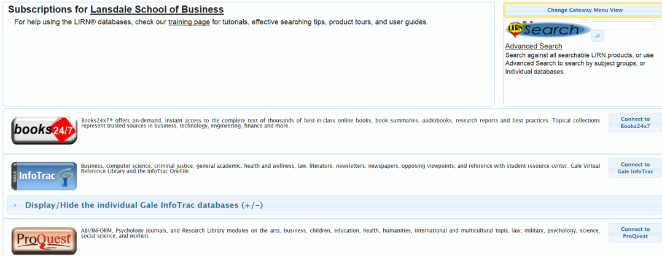
Books 24x7 database e-Books and videos
Click on the Books 24x7 button to access books and videos.

Slide 20
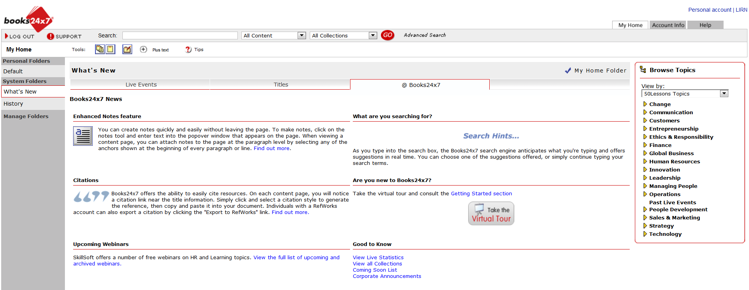
Books 24x7 continued
Select desired topics by the Browse Topics pull down the drop down menu then click on the desired category and select a video to stream
or to read an e-book. Any of these videos may be shown in class without violating copyright.
.

Slide 21
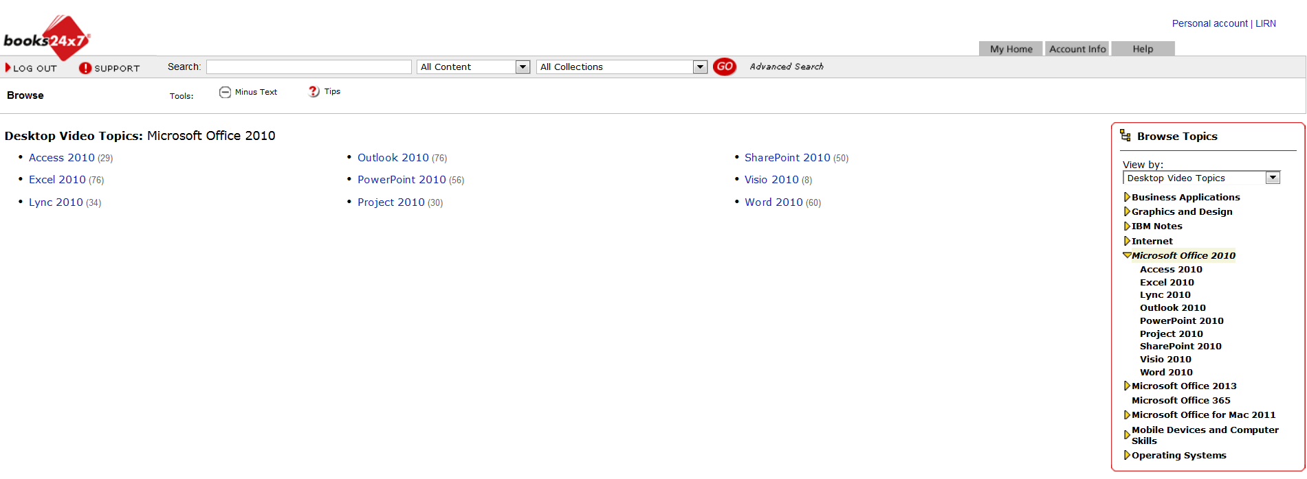
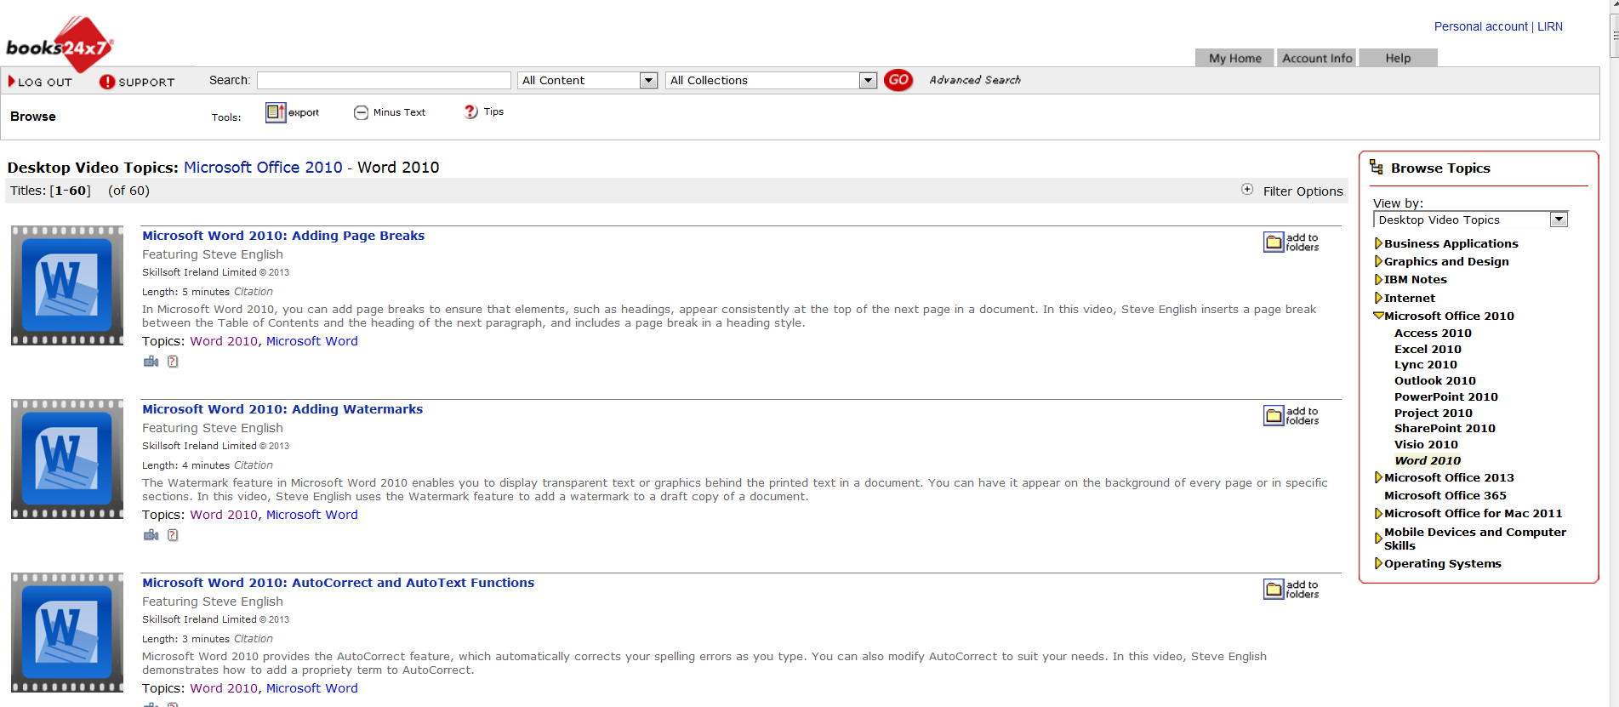
Books 24x7 continued
You can choose from; 50 Lessons Topics (short videos on a variety of business/ leadership topics); Desktop Videos Topics (computer applications); IT and Technical Video topics, Leadership Development Channel Topics, Business Topics, IT and Technical Topics, and Well-Being Topics.

Slide 22
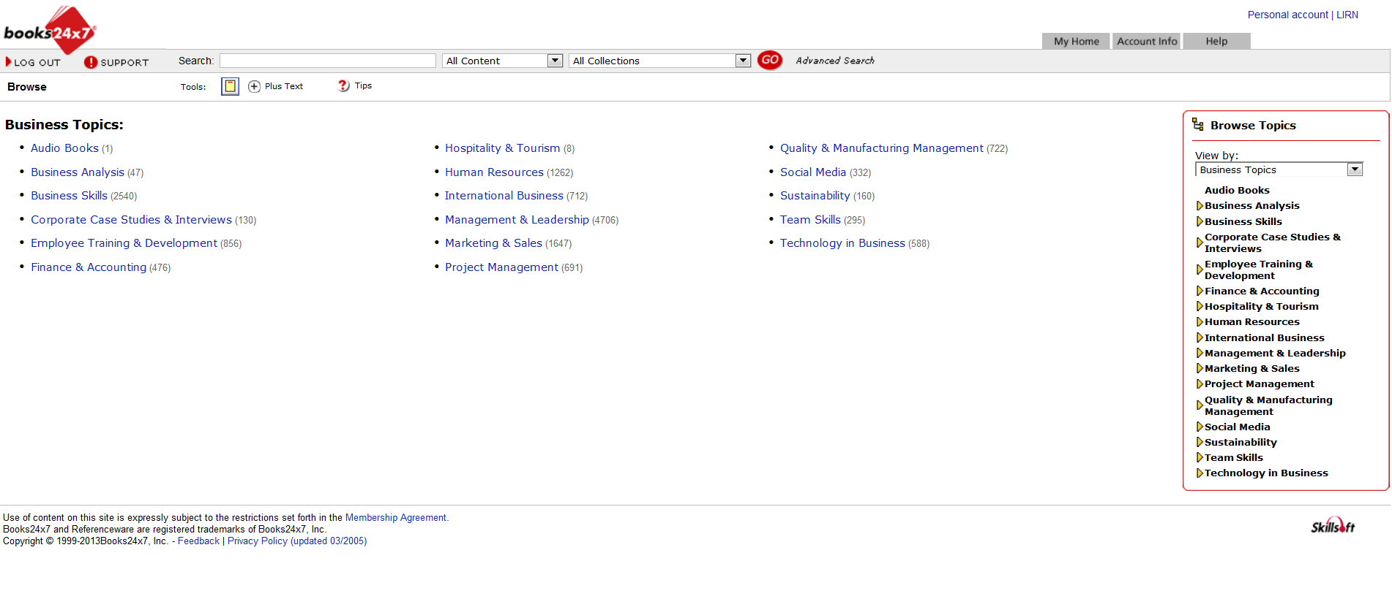
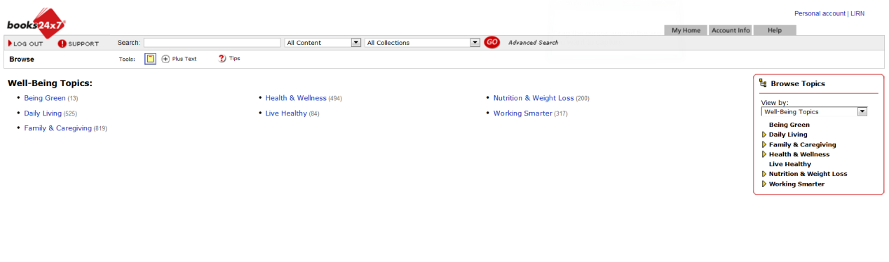
Books 24x7 continued
Business topics include: Business Analysis, Business Skills, Corporate Case Studies & Interviews, Employee Training & Development, Finance & Accounting, Human Resources, Management & Leadership, Marketing & Sales, Social Media,
Team Skills, and Technology in Business, etc.
Health and well-being topics include books on allied health, finance, law, psychology, social issues, and career topics.

Slide 23
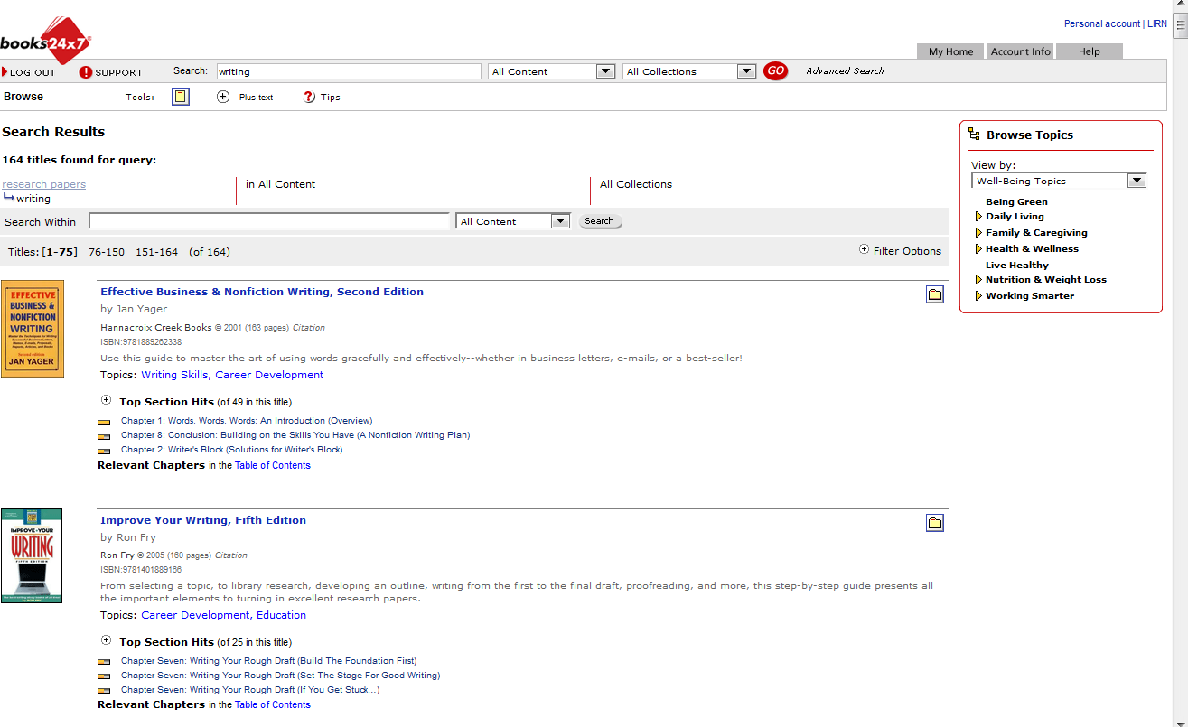
Search and Retrieve e-books
Type in search terms. Select All Content and All Collections. Go.

Slide 24
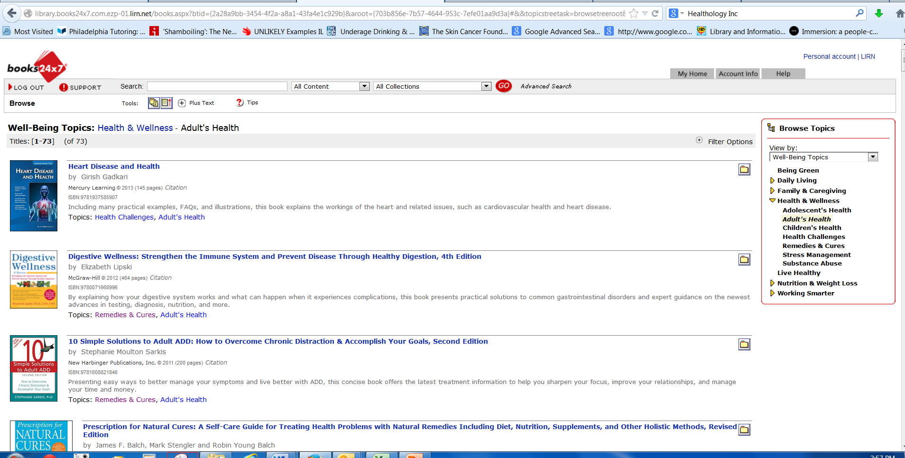
Books 24x7 continued
E-Books can be read online by clicking on the title for the entire book or a chapter within the book for specific information. A citation generator is provided. Click on the word Citation to access it.

Slide 25
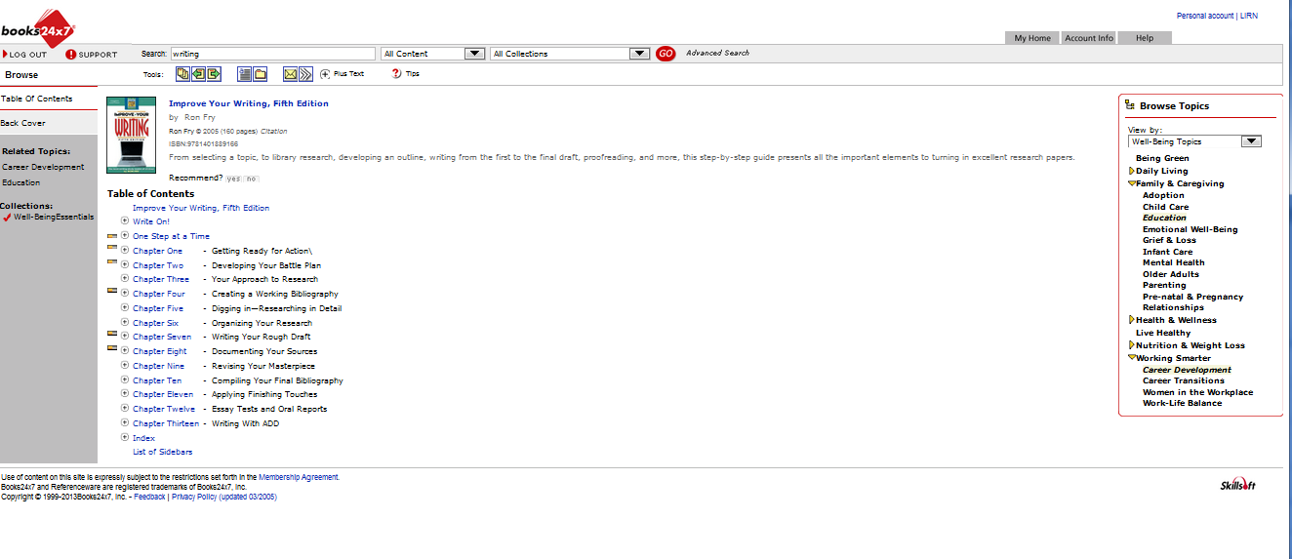
Click on the Book Title to Read
Read the pertinent chapters by clicking on the hypertext.
Generate a citation by clicking on Citation.

Slide 26
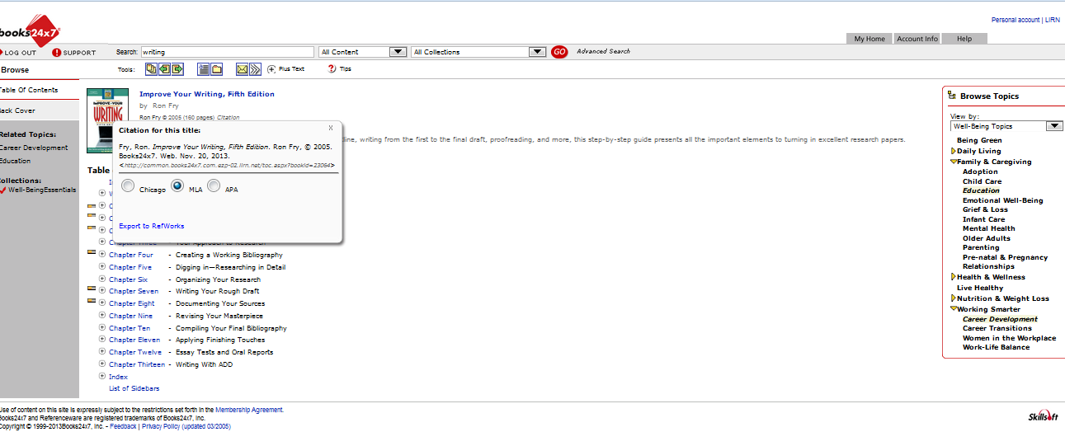
MLA Citation
Select MLA and copy/paste into a Word document

Slide 27
MLA Citation
Fry, Ron. Improve Your Writing, Fifth Edition. Ron Fry, 2005. Books24x7. Web.
Nov. 20, 2013.
Don’t use the URL for database resources.

Slide 28
Most books will have to be read online; however, some may be saved to a Word document if the publisher permits.

Slide 29
Gale Virtual Reference
Gale Virtual Reference Library (GVRL) is a database of encyclopedias and specialized reference sources for multidisciplinary research.
GVRL can be accessed online, its content downloaded and saved or printed, and MLA documentation generated.

Slide 30
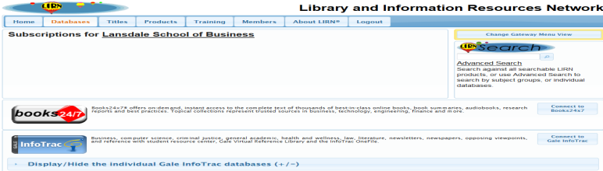
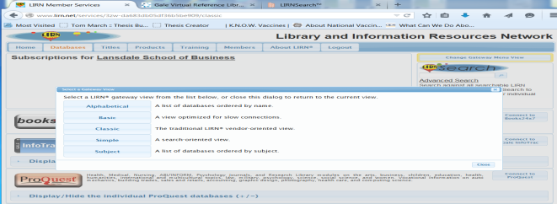
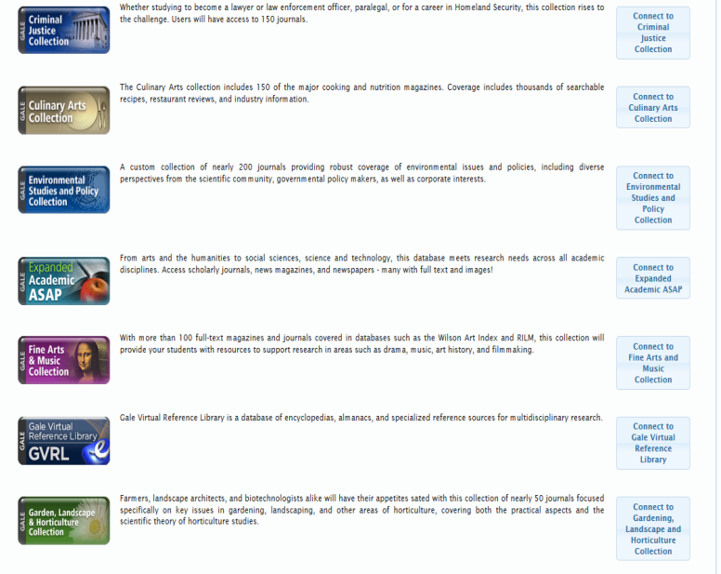
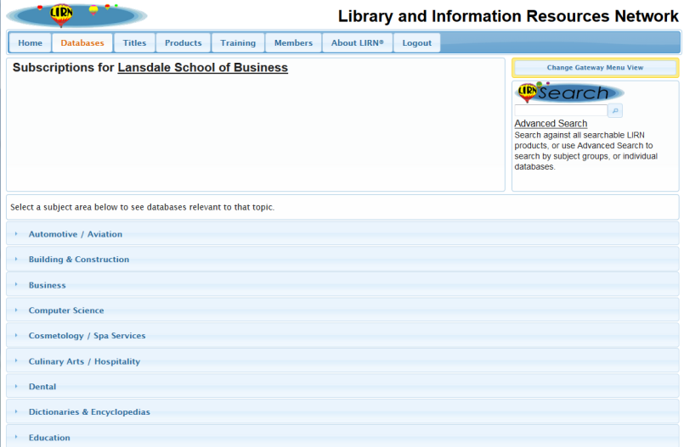
GVRL
Access GVRL through the Gale InfoTrac database list on the LIRN Member Services page
Access GVRL through the Change Gateway Menu View selecting Subject View list under Dictionaries and or Encyclopedias.

Slide 31
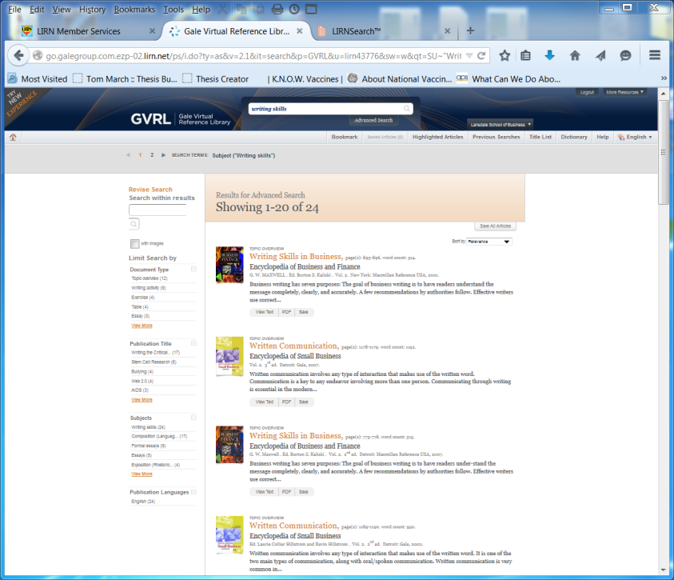
Finding Books on GVRL
Type in search term and click enter
Select chapters by clicking on orange title
Select complete work by clicking on black titles

Slide 32
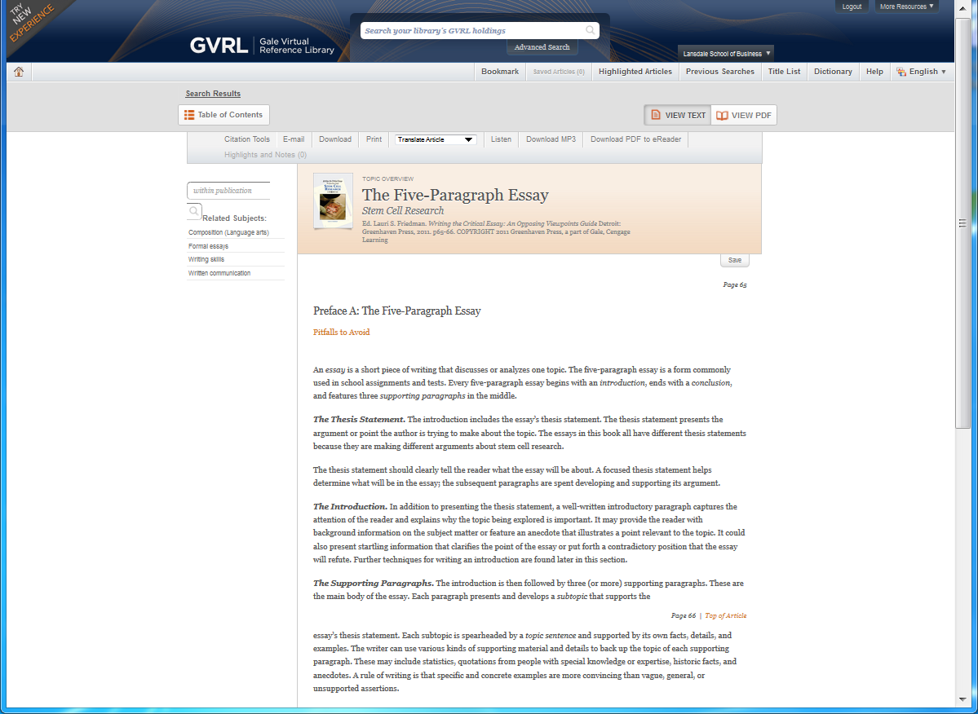
Reading Printing Saving Citing in GVRL
MLA Citation Email Save Print

Slide 33
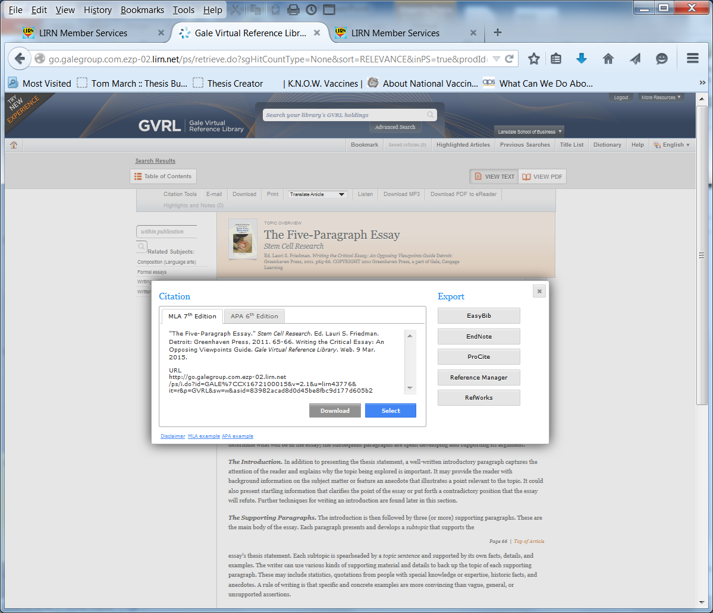
MLA in GVRL
"The Five-Paragraph Essay." Stem Cell Research. Ed. Lauri S.
Friedman. Detroit: Greenhaven Press, 2011. 65-66. Writing the
Critical Essay: An Opposing Viewpoints Guide. Gale Virtual
Reference Library. Web. 9 Mar. 2015.

Slide 34

LIRNSearch
LIRNSearch is a federated search engine that allows you to simultaneously search all of the LIRN sources or to search by subject groups, or as individual databases. Like Google LIRNSearch will retrieve any resource that matches the search, some that are appropriate and some that are inappropriate for your needs. You can narrow your results by using the Advanced Search function or search in specific Subject databases using the Advanced Search function.

Slide 35
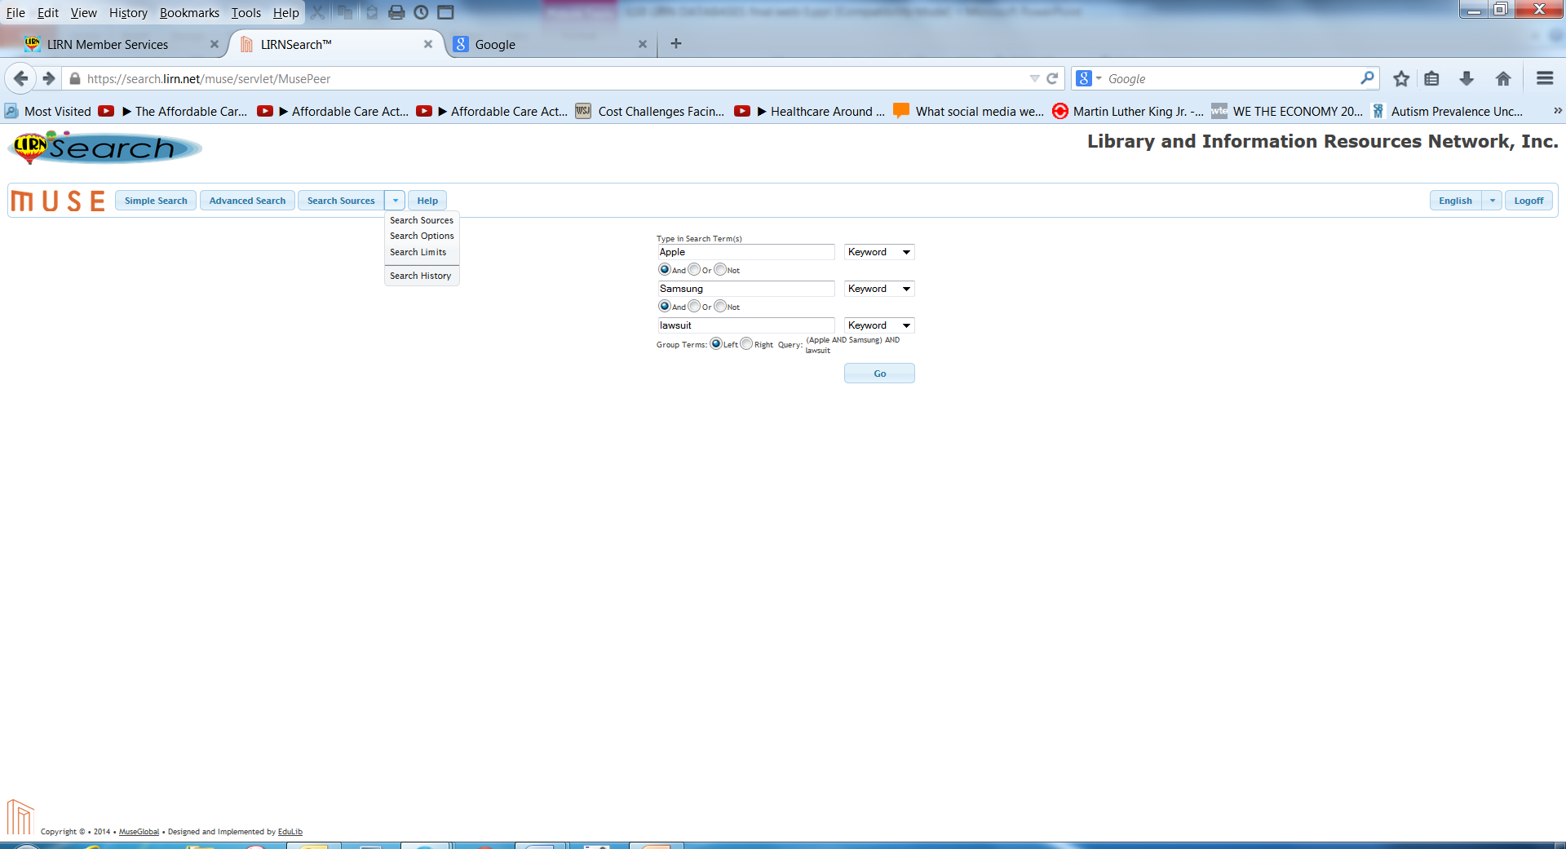
Search and Retrieval of Articles
Set the Search Options, Search Limits, and Search Sources, and type on the search terms in order of priority: first box should contain main topic, following boxes contain limiting terms and click Go button to retrieve search results.

Slide 36
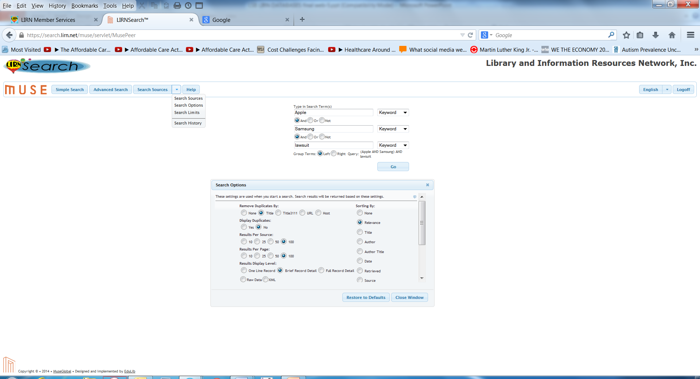
Selecting Search Options from
Advanced View
Select Sort preference by Date, Relevance, Author, etc.
Remove Duplicates,
Select Number of Results Per Source and Per Page

Slide 37
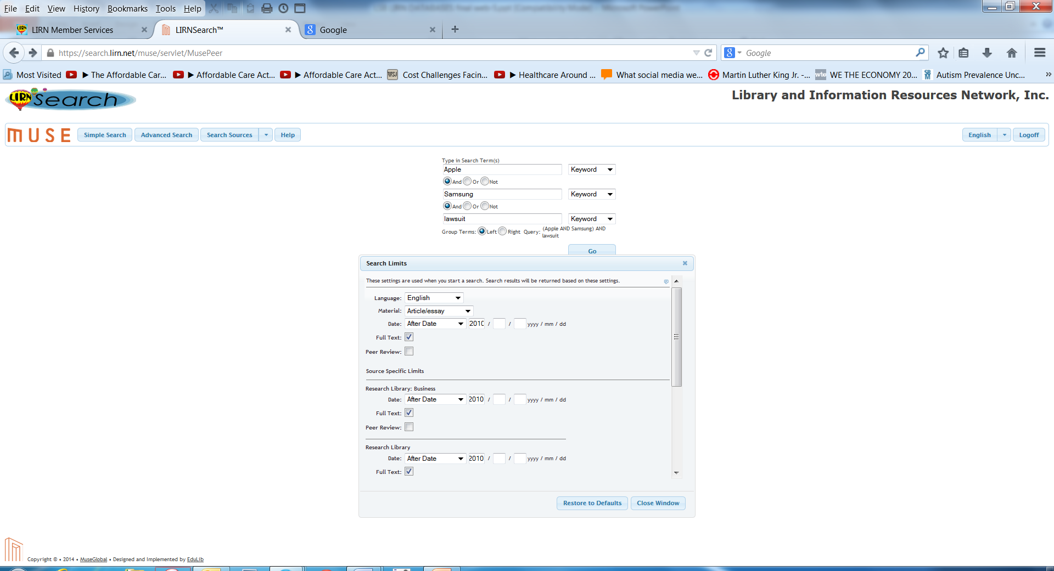
Selecting Search Limits Options from Advanced View
Always select English, Type of Material, Full Text, and Date Range for all selected sources

Slide 38

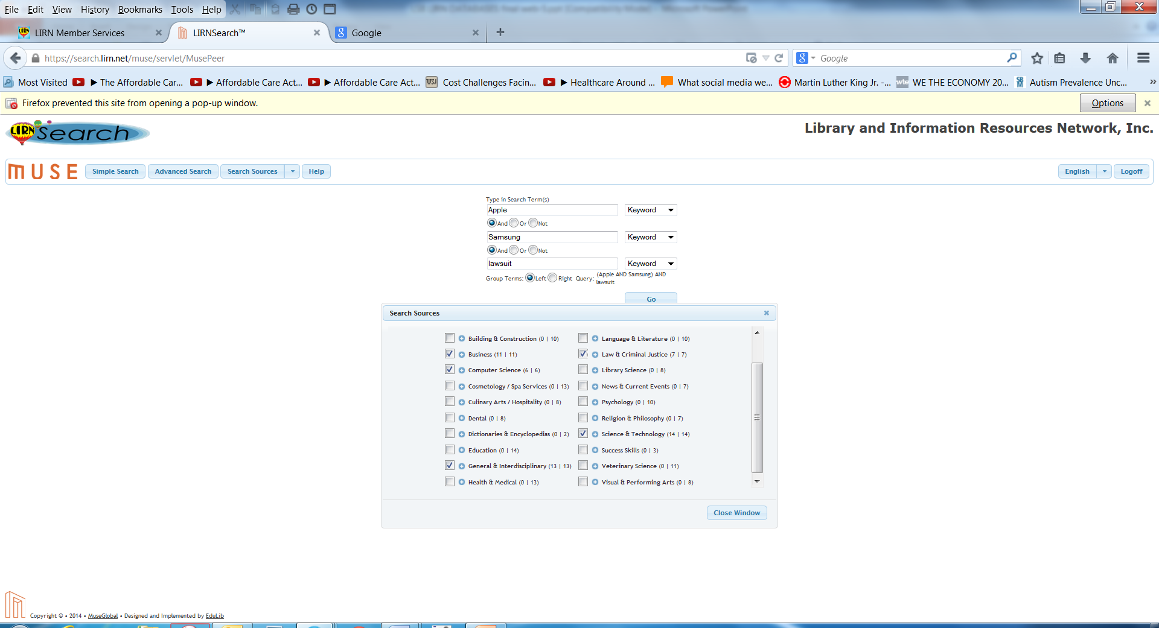
Selecting Search Sources Subject Database Collections in Advanced View
Select database collections to search. Uncheck All Sources. Choose only those databases that are pertinent to your purpose by clicking on the box by the subject to search the collection or individual boxes to search specific databases within the collections by clicking on the adjacent to the collection title.

Slide 39
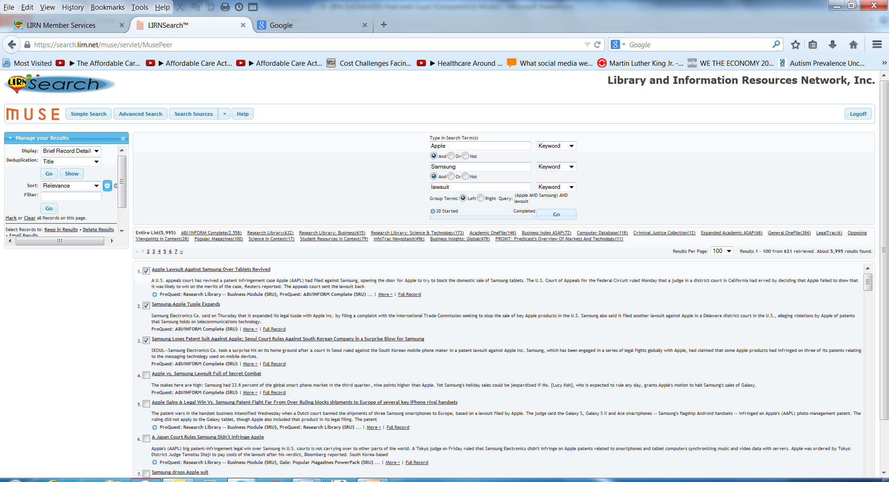
Search and Retrieval of Articles
Click on the box adjacent to the title to select for a Results list that you can save for later retrieval or click on the title of an article to retrieve it now.

Slide 40
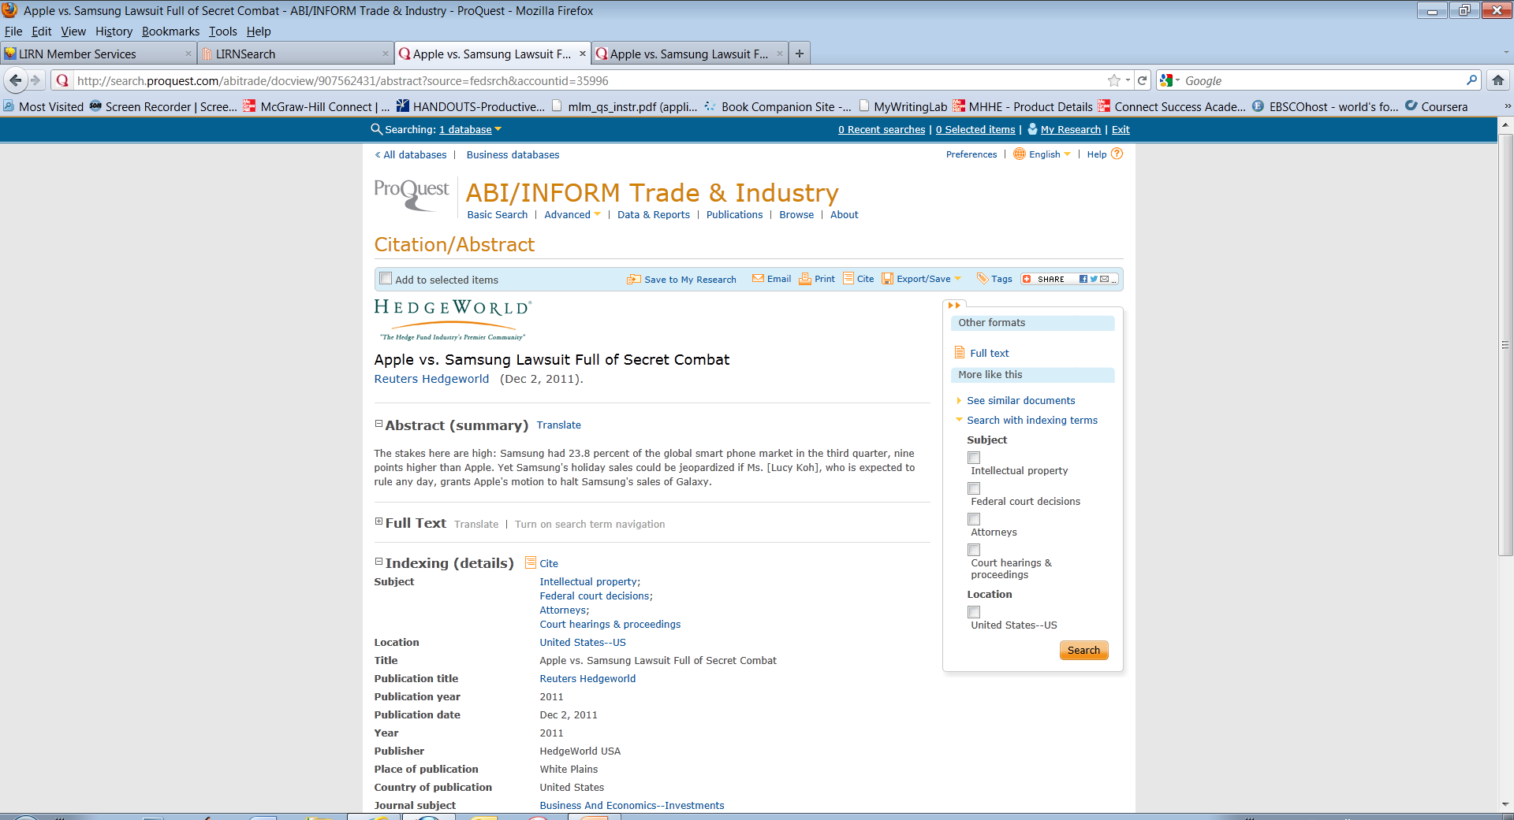
Retrieving Full Text Articles
Clicking on title will bring you to the Citation /Abstract
Screen where you can read or access the full text of the article. If necessary, click Full Text, PDF, or Link to Full Text link to view the article.

Slide 41
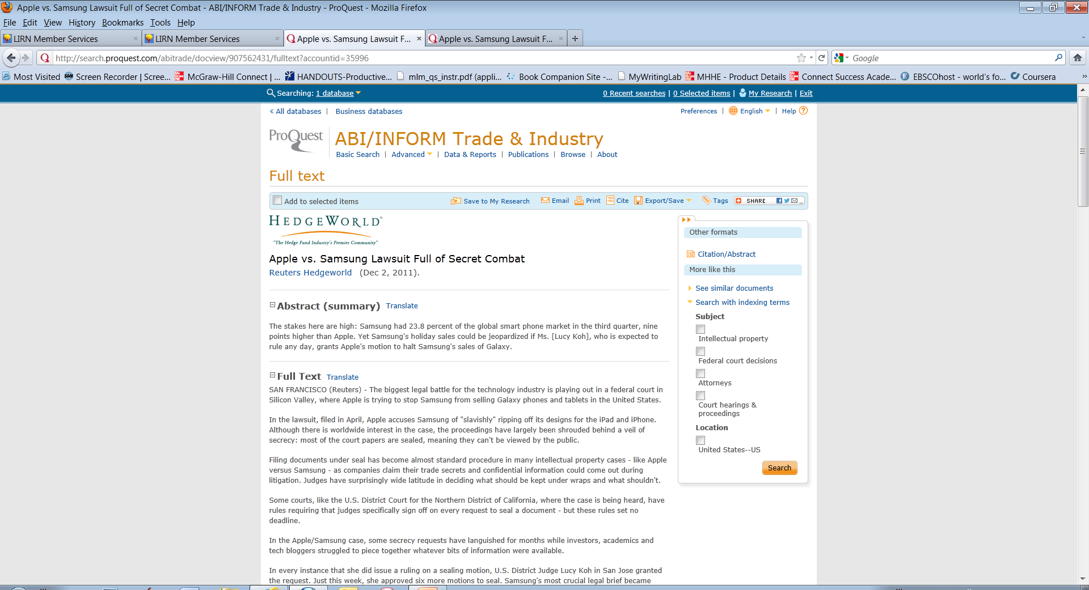
Full Text Display
Read, Save to your “My Research” folder, Email, Print, Cite, or Save to your drive as a PDF. Click on the link to perform an action.

Slide 42
ProQuest: My Research
Gale Databases: Saved Documents
ProQuest and Gale Databases allow you to save retrieved articles in a personal folder that you establish.
You must sign into your folder in those databases in order to save your selected articles.
Check the boxes adjacent to the entry to save the article.
Selected entries are remembered only for the duration of your session. If you close your browser or start over before saving to your folder, the list of marked entries will be cleared.

Slide 43
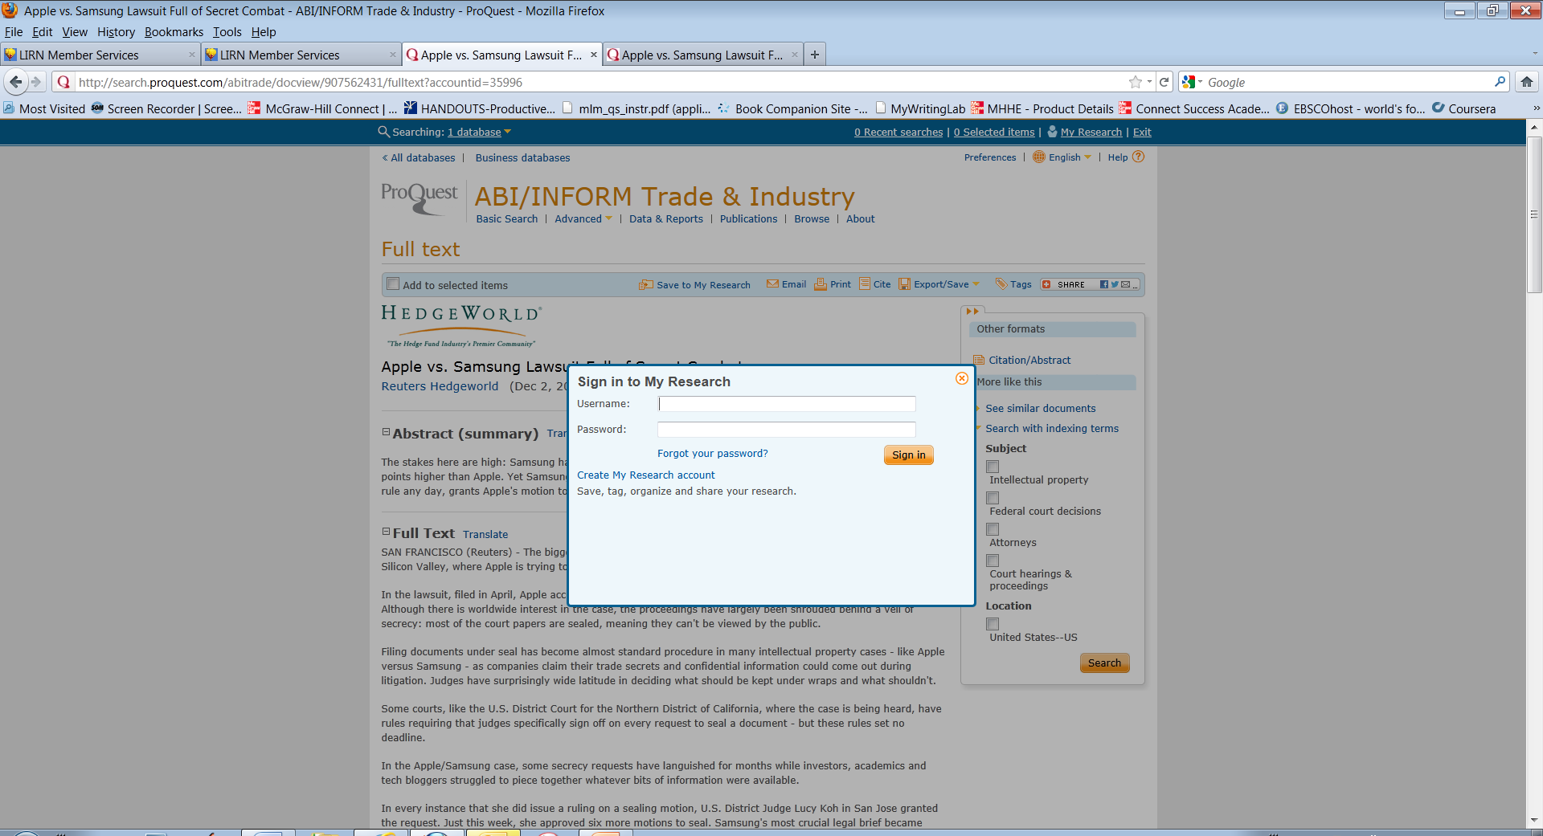
ProQuest: My Research
Create an account for your personal folder in My Research. Once an account is created, sign in to your folder when you wish to save articles.

Slide 44
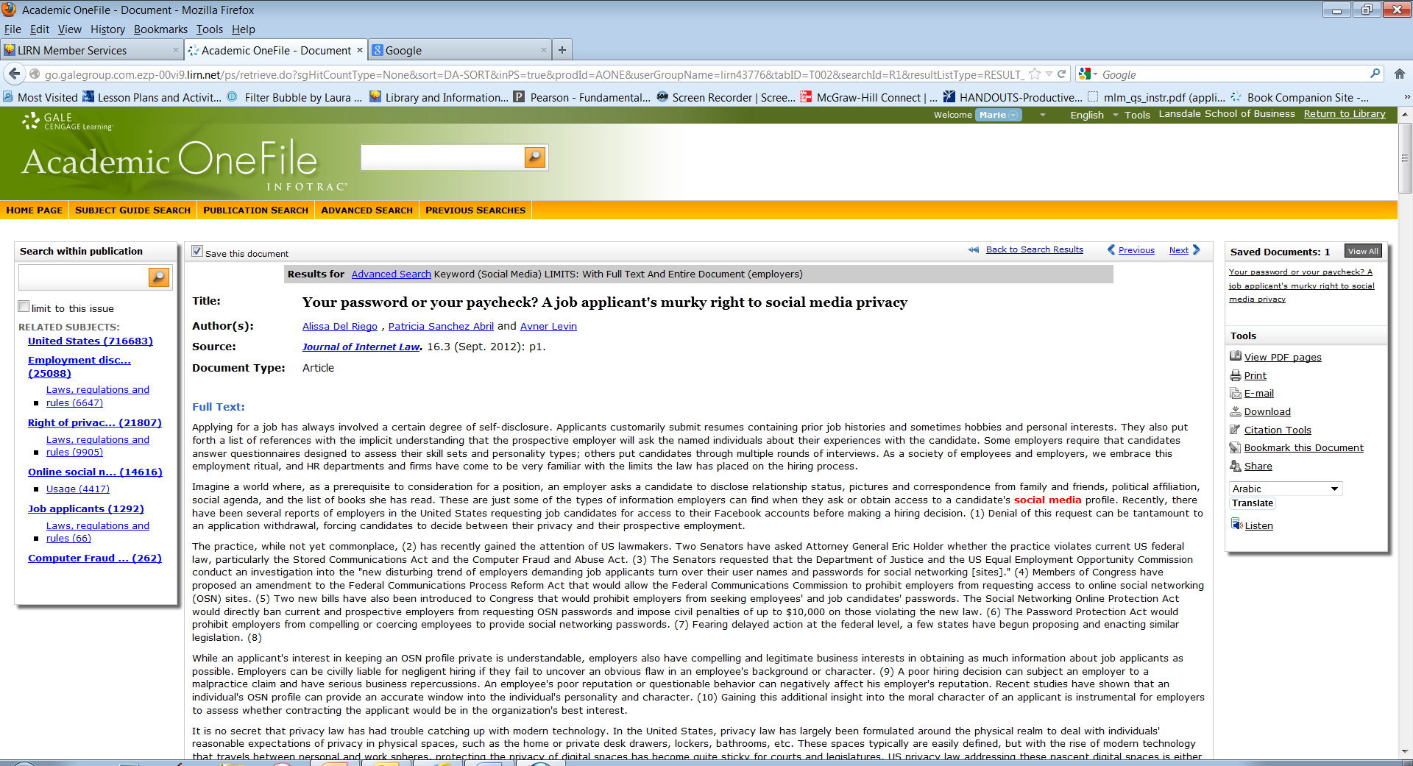
Gale Databases: Saved Documents
Create an account for your personal folder in Saved Documents (Have an account?). Once an account is created, sign in to your folder when you wish to save articles and check the Save this document box.

Slide 45
Gale In-Context Databases
Some Gale databases do not have a personal folder feature. Use the Bookmark link to save your search in an email that will link you to the list of your saved results when you open. You must log in to LIRN to gain access to the saved result list.

Slide 46
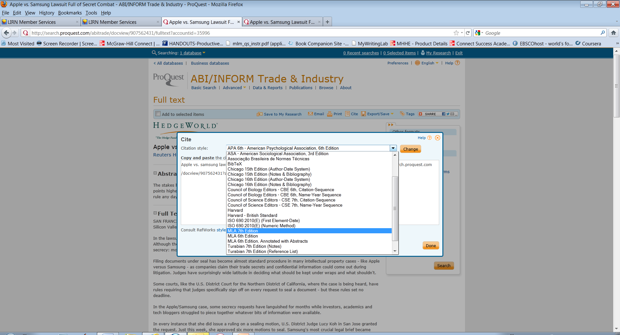
Generating an MLA Citation in ProQuest
Click on the Cite link to generate a citation.
Select the MLA 7th Edition format and click the Change button to generate the citation.

Slide 47
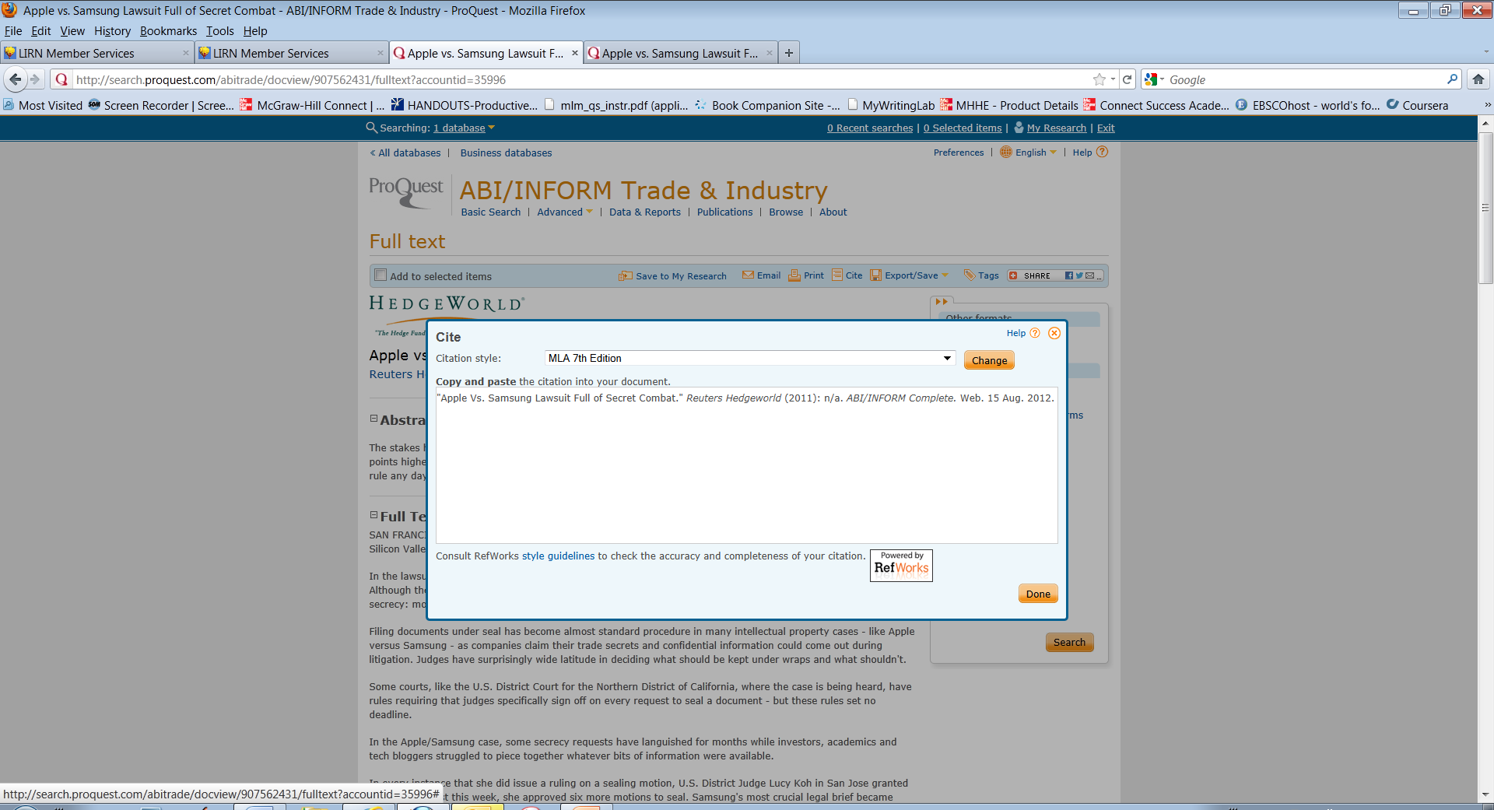
Generating the MLA Citation
Copy/paste the MLA citation into your document.

Slide 48
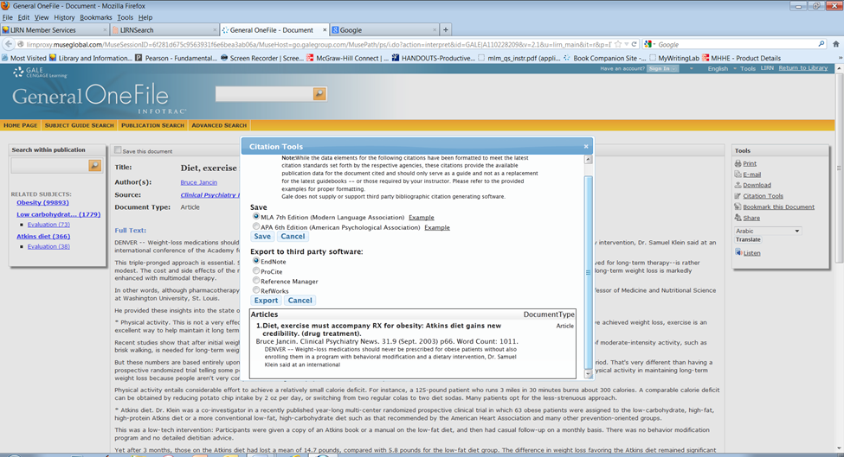
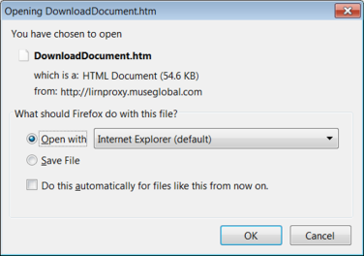
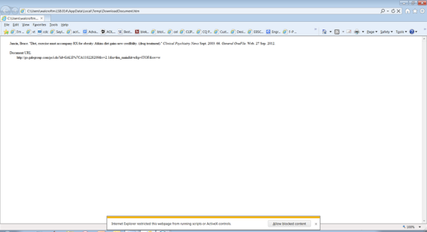
Other citation generators are located on the right sidebar or end of the article. You must copy/paste the generated citation into Word

Slide 49
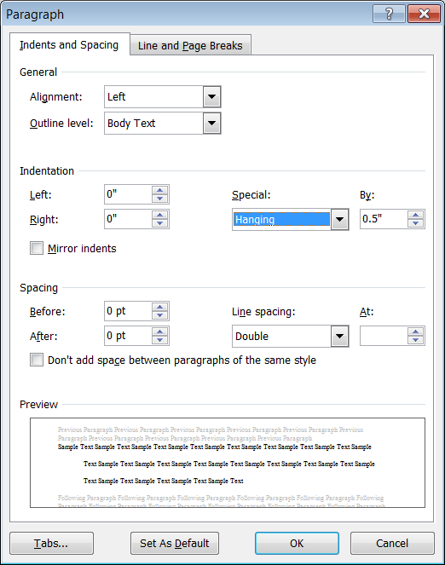
Format the MLA Citation in WORD
"Apple Vs. Samsung Lawsuit Full of Secret Combat." Reuters Hedgeworld (2011): n/a.
ABI/INFORM Complete. Web. 15 Aug. 2012.
Make sure to set Spacing, Line Spacing and Hanging Indentation.
Use size 12pt, Times New Roman font.

Slide 50
Need Assistance? Just Ask!
Please contact or meet with me if you are in need of assistance. I’m here to help you…
  Find information on your research topic
  Navigate our databases and online catalog
  Search and evaluate online resources
  Cite your resources
Marie Walcroft
mwalcroft@lsb.edu
215-699-5700
Hours: Monday-Thursday, 8:00 AM – 6:00 PM

